Slide 1
HTL Wiener Neustadt
Higher Technical Institute
2CHIF

Slide 2

location
Wiener Neustadt, Lower Austria
Population: 44.461
Area: 61km²

Slide 3

Basic information
Students: about 1500
Headmistress: Mag. arch. Ute Hammel
Teachers: 140
Departments: 4
Each department has its own subjects and its own division of theory and practice. We have about 34 weekly hours from which a quartal is practical.

Slide 4

Departments
Mechanical engineering
Construction Technology
Electrical engineering
Informatics

Slide 5
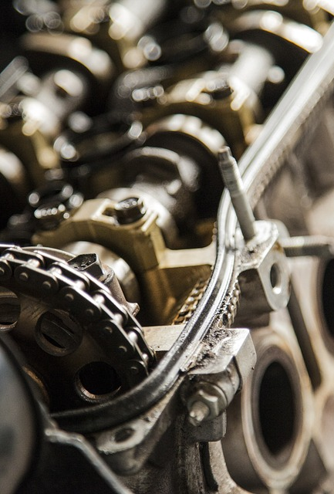
Mechanical engineering
One of the main things you learn in this Department is automation technology, which is an individual science of engineering. It‘s goal is to make machinery work independently and without human intervention. You also learn how to use mechanical engineering specified formulas, e.g. calculating forces.

Slide 6


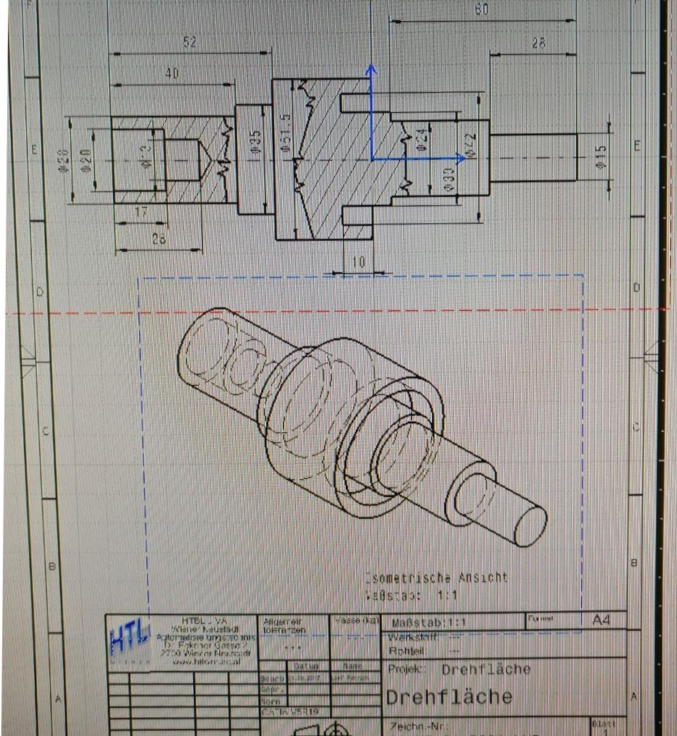
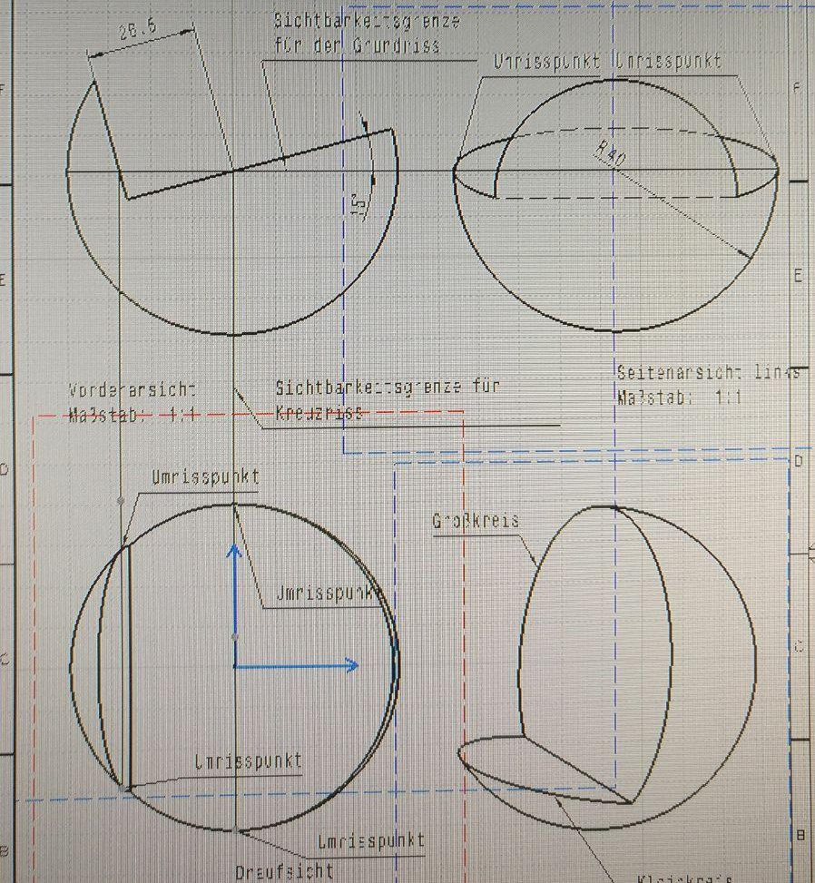
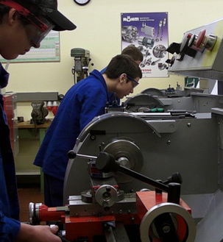
Examples

Slide 7

Departments
Mechanical engineering
Construction Technology
Electrical engineering
Informatics

Slide 8
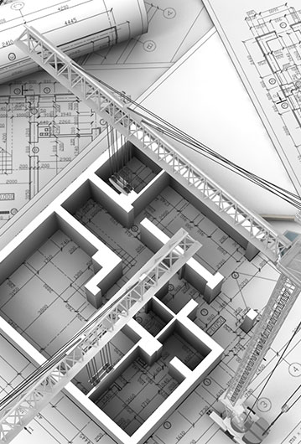
Construction technology
In this department you learn to construct buildings,
which building materials are used and you get some
practical experience in building stuff.

Slide 9
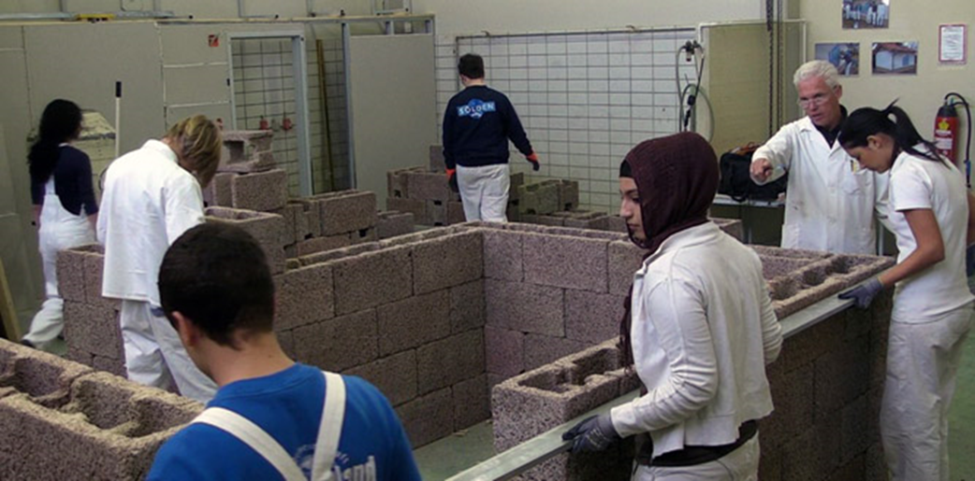
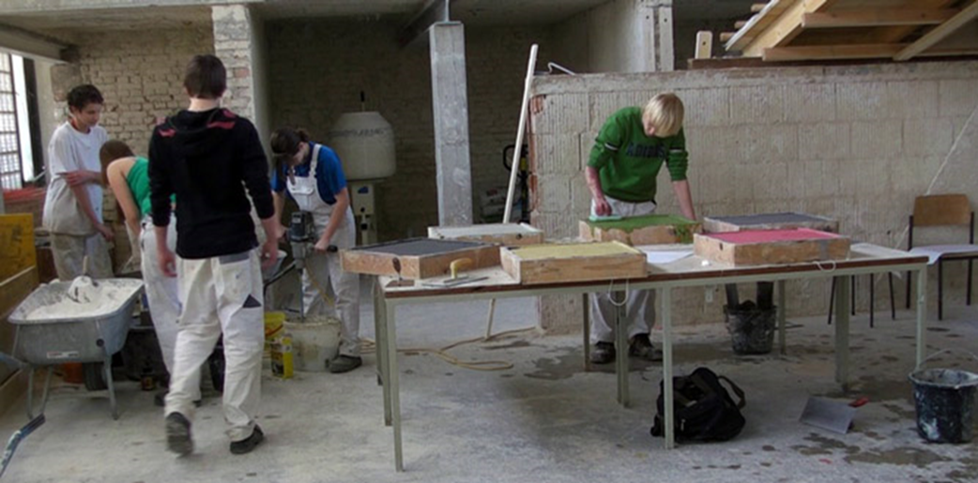
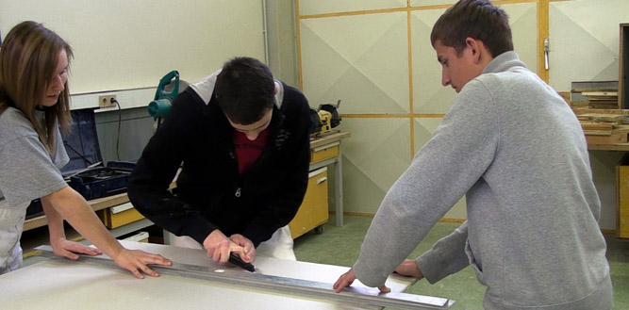
Examples

Slide 10

Departments
Mechanical engineering
Construction Technology
Electrical engineering
Informatics

Slide 11
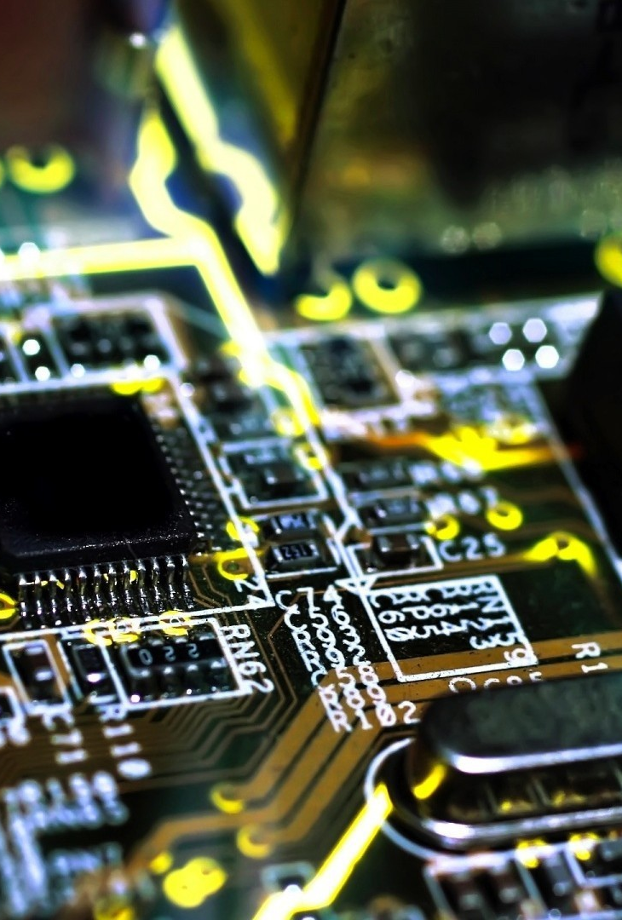
Electrical engineering
In this department you learn about …
Energysystems: electrical engineering basics, low voltage and high voltage technology, lighting technology, home, building and security technology, renewable energy, conventional energy generation and energy transmission
Automation Technology (described later)
Drive technology: electromagnetism, basic principles of mechanical engineering, electrical machinery, energy converters, power electronics and drive systems
Industrial electronics: analog and digital basic circuits, power electronics, circuitry and transmission technology
… and some other cool stuff.

Slide 12
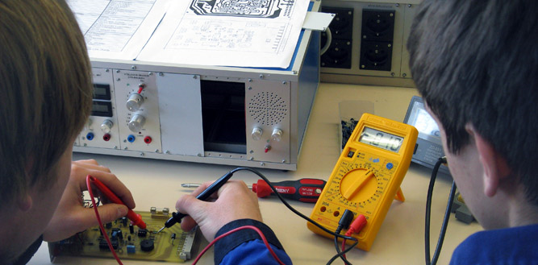
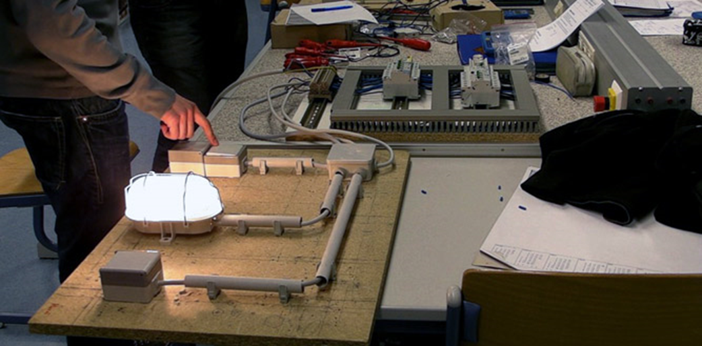
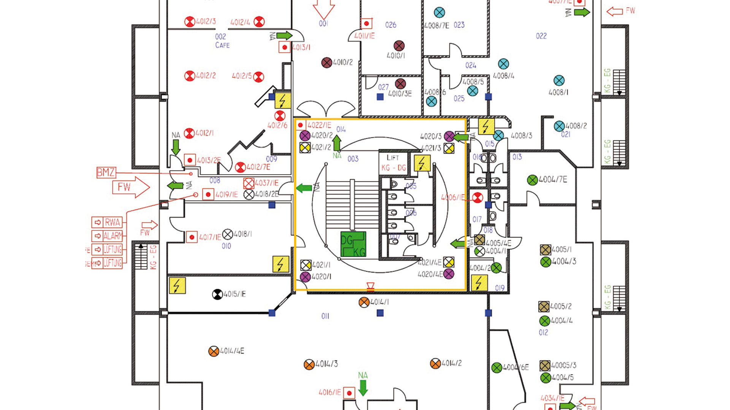
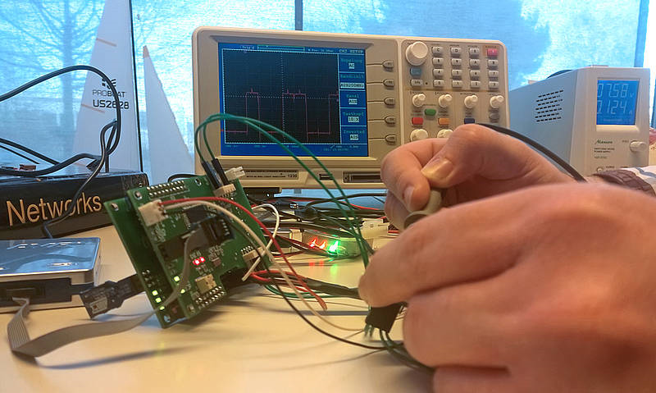
Examples

Slide 13

Departments
Mechanical engineering
Construction Technology
Electrical engineering
Informatics

Slide 14

Informatics
In this department you learn some programming languages, project planning, network technology and much more.
Programming languages we learn are …
Python
C++
HTML
PHP
Java
C#

Slide 15
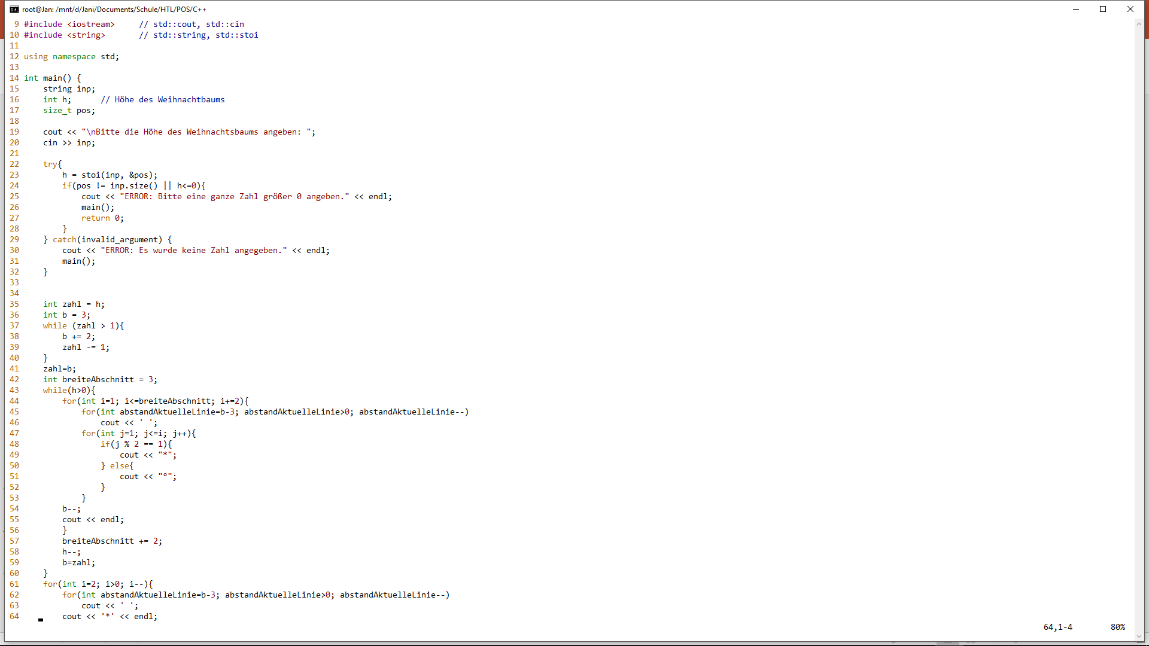
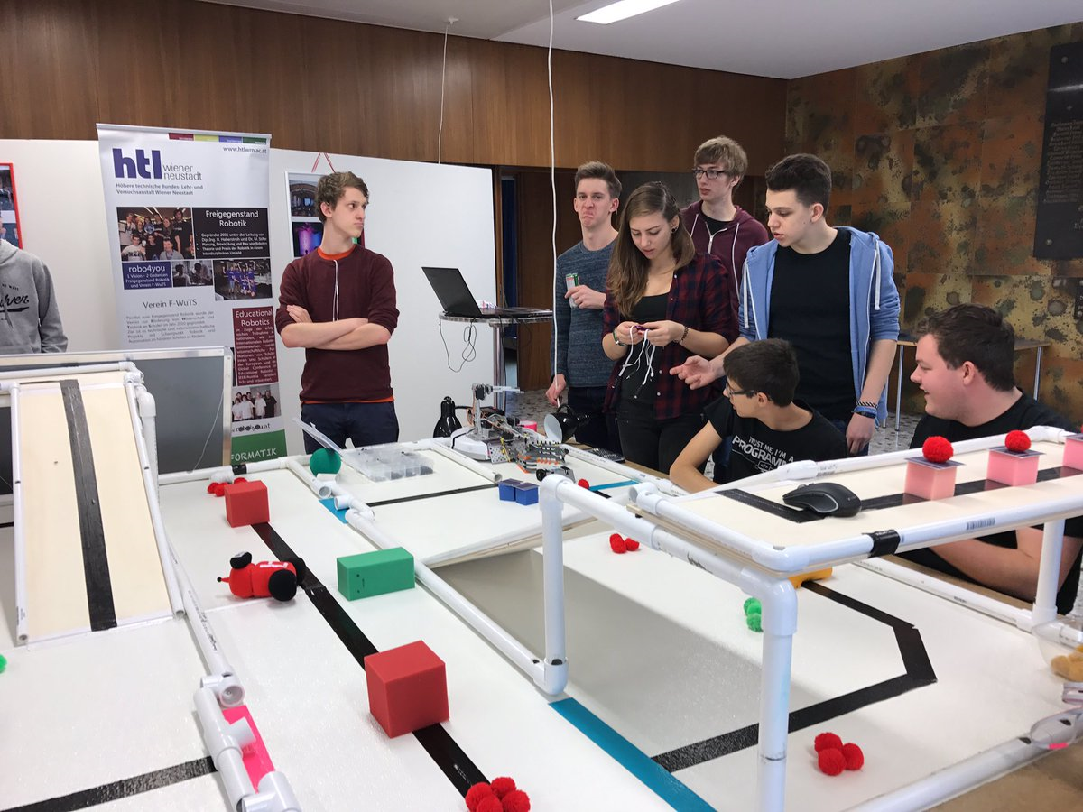
examples

Slide 16
Thanks for Reading!
We hope you enjoyed this little trip through our school!
We‘re looking forward to program with you!
Kindest greetings from Austria!

